Slide 1
Worst California Contact Poison Plants
By Sean Magers

Slide 2
Poison Oak
Poison Oak can make a rash appear where the body has contacted the oil. It can also form on parts of the body not contacted by the plant. It starts with itching and a small irritation, and then slowly worsens turning into a red rash that gets more itchy. Bumps will form, which can turn into blisters
Poison Oak leaves look a lot like oak leaves, and like poison ivy, they usually grow in clusters of three. But some kinds of poison oak have five, seven or nine leaves per cluster. Poison oak usually grows as a shrub in the Southeast or along the West Coast. It bears clusters of greenish yellow or white berries.The leaves are green during the Spring and then start turning red during the Summer.

Slide 3
How to avoid Poison Oak and what to do if you do touch it
You should Keep your skin covered to avoid contact with these plants. Wear a long-sleeved shirt, long pants, gloves, and closed shoes if you're in an area where they grow.
If you have touch poison oak, or ivy immediately wash areas of the skin that may have been touched by the plant. Sometimes the rash can be completely avoided by washing the affected areas with lots of water and soap or rubbing alcohol. Rinse often, so that the soap or rubbing alcohol doesn't dry on the skin and make the rash worse. Use creek or stream water if you are outdoors.
Do not scrub hard when you wash, so you don't irritate the skin. Also, be careful to clean under the fingernails, where the oil can collect and spread easily.

Slide 4
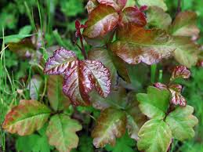
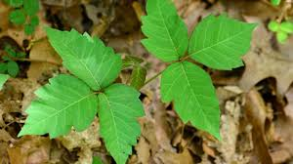
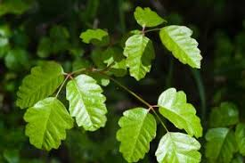
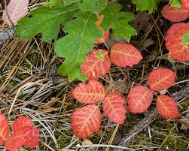
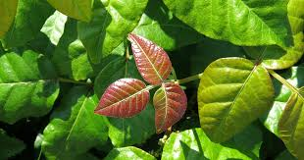
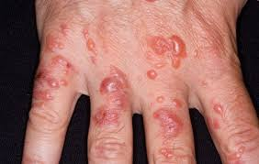

Slide 5
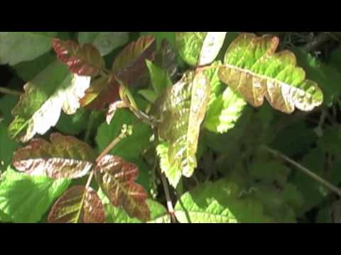
Video

Slide 6
Stinging Nettle
Stinging nettle has fine hairs on the leaves and stems that contain irritating chemicals, which are released when the plant comes in contact with the skin. The hairs, or spines, of the stinging nettle are normally very painful to the touch. Stinging nettle is the name given to common nettle, garden nettle, and hybrids of these plants. Originally from the colder regions of northern Europe and Asia, this herbaceous shrub grows all over the world today. Stinging nettle grows well in moist, nitrogen-rich soil, blooms between June and September, and usually reaches 2 to 4 feet high.
Stems are upright and rigid. Leaves are heart shaped, finely toothed, and tapered at the ends, and flowers are yellow or pink. The entire plant is covered with tiny stiff hairs, mostly on the underside of the leaves and stem, that release stinging chemicals when touched.

Slide 7
How to avoid Stinging Nettle and what to do if you do touch it
The best way to prevent stinging nettle rash is to familiarize yourself with what the plants look like and take measures to avoid coming into contact with them.You should keep your skin covered to avoid contact with these plants. Wear a long-sleeved shirt, long pants, gloves, and closed shoes if you're in an area where they grow
It’s important to try not to touch the rash for the first 10 minutes after receiving the sting. This is because if the chemicals are allowed to dry on the skin, they’re easier to remove.Any touching or rubbing could push the chemicals deeper into the skin and cause the reaction to be more severe and last longer.After 10 minutes, use soap and water to wash away the chemicals from the surface of the skin. This can often be enough to greatly reduce or completely remove any pain, itching, or swelling.

Slide 8
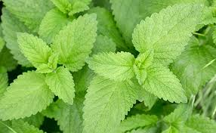
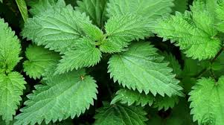
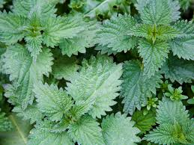
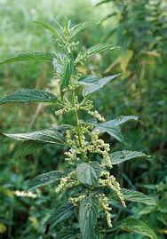
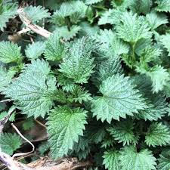
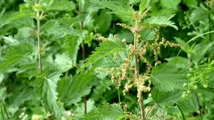

Slide 9
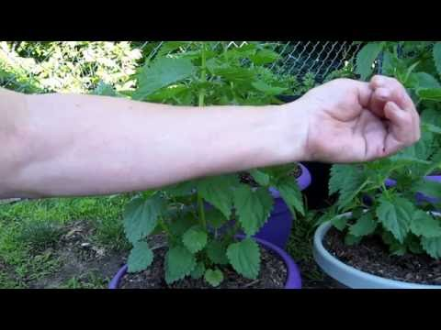
Video

Slide 10
Poodle-dog Bush
Eriodictyon parryi or poodle-dog bush is a tall California mountain shrub with showy purple flowers, which is notable for secreting a severe skin irritant. It is an opportunistic species that grows mostly in areas that have been disturbed by fire.This plant can be 2-6ft tall
Poodle-dog bush causes severe irritation to the skin if touched, akin to poison oak or poison ivy. It can raise blisters lasting as long as two weeks or more. The plant is covered in sticky hairs, which can dislodge easily and can be passed on to hikers who touch it or brush up against it.

Slide 11
How to avoid Poodle-dog Bush
and what to do if you do touch it
The best way to prevent Poodle-dog Bush blisters is to familiarize yourself with what the plants look like and take measures to avoid coming into contact with them.You should keep your skin covered to avoid contact with these plants. Wear a long-sleeved shirt, long pants, gloves, and closed shoes if you're in an area where they grow.Even if you wear all of these things, it can still get through so if you are not 100% sure you can avoid it, then do not go down that trail.
If you do touch it wash the affected area with soap and water as soon as possible. Any clothes suspected to be contaminated should not be touched, and should be washed whenever possible

Slide 12
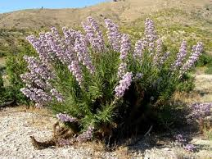
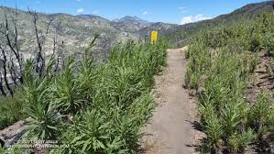
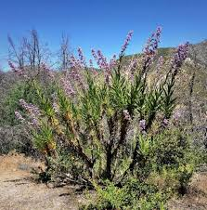
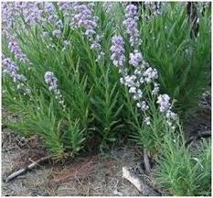
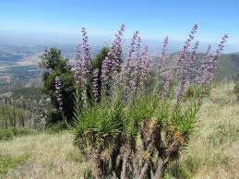
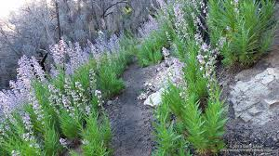

Slide 13
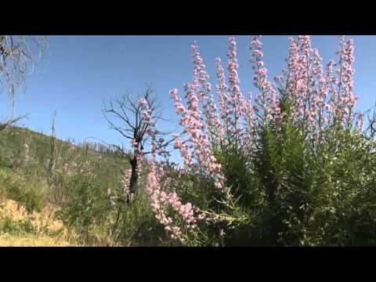
Video

