Slide 1
Flag Etiquette

Slide 2
Flag etiquette
Don’t let the flag touch the ground or else…
Don’t carry the flag horizontally or flat
Carry the flag in a standing position cause it means the flag is free
Don’t do anything that will damage the flag
Never fly a flag upside down cause if it is upside down, it means surrender
Display the flag ONLY when the weather can’t damage it

Slide 3
What to do during a flag ceremony
-When the flag is being raised by the color guard, salute
-Recite the pledge of allegiance or national anthem(only when it is being raised)
-render a hand salute when the person in charge says “Attention!”
-If you are not in uniform, place your right hand over your heart

Slide 4
What to do during a parade
-Salute the flag when it is passing by you and stop only when the flag passes you area

Slide 5
How to display the flag:part 1
- The flag must be properly folded and rolled onto a mast or carried by hand
-Flags should not be stored until they are dry
-When you fold the American flag, make sure no red is showing at the end
-The US flag should be displayed crossed on a wall if it is displayed with another flag
-If the flag is displayed in the middle of street, it should be displayed vertically

Slide 6
How to display the flag:part 2
-When the US flag is displayed with flags of organizations, cities, and states, it should be at the peak
-The US flag should be hoisted first and lowered last when the flags are on adjacent masts
-When displaying the flag on a wall, display it vertically or horizontally
-When the flag is displayed on balcony, it should be angled skywards
-When the flag crosses paths with other flags during a procession, it should pass in front of the direction of travel

Slide 7
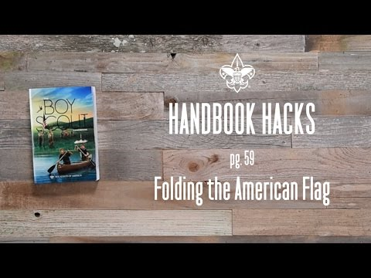
How to properly fold a flag

